Slide 1
Wide Field Slitless Spectroscopy
(WFSS, pronounced Weefiss)
Colin Jacobs
JWST MASTER CLASS MELBOURNE 2022

Slide 2
Grism Spectroscopy Basics

Slide 3
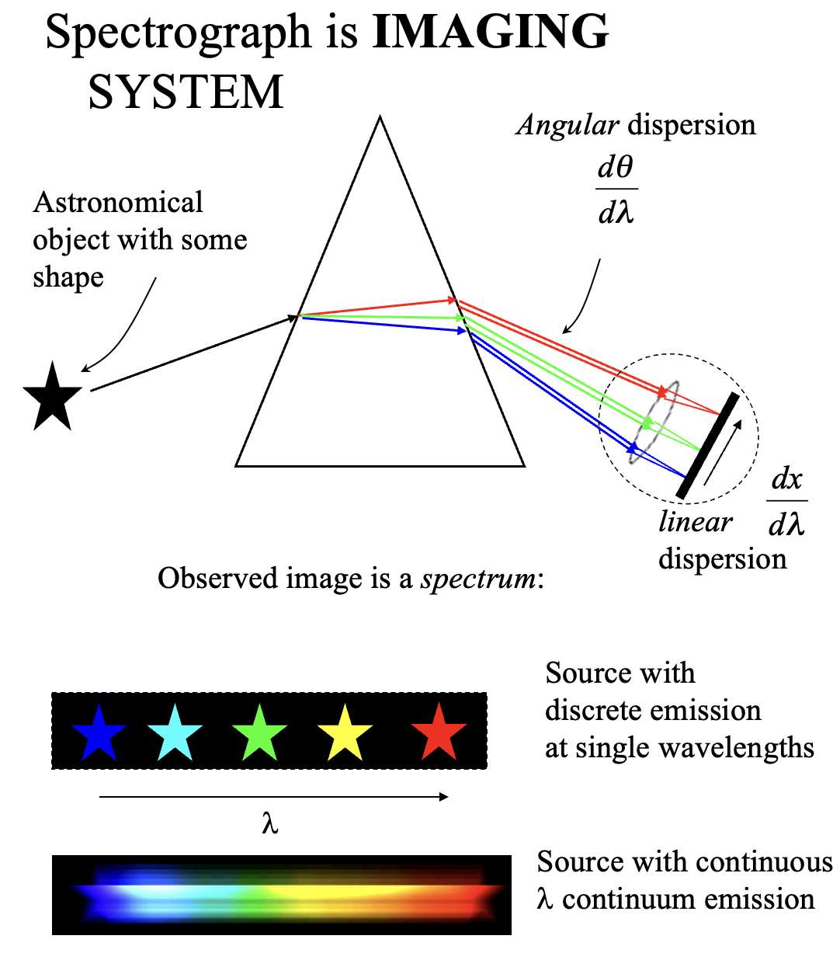
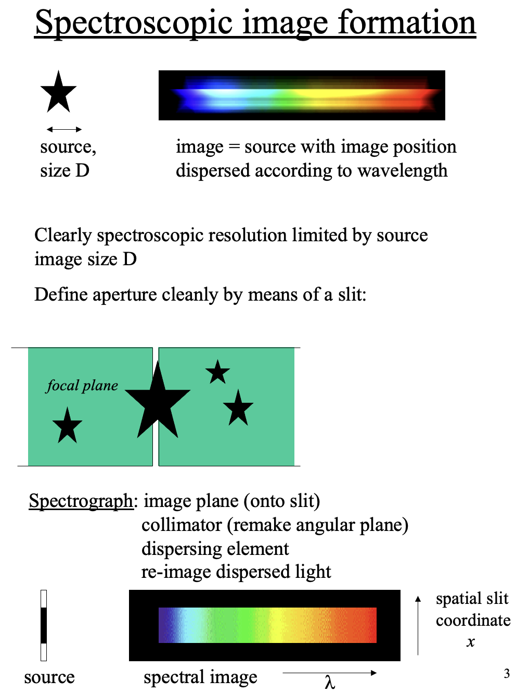
(Glazebrook slides)

Slide 4

Grism Diffraction - Monochromatic Light

Slide 5
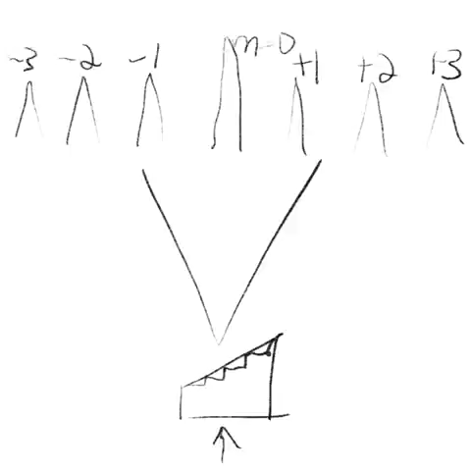
Grism Spectroscopy

Slide 6
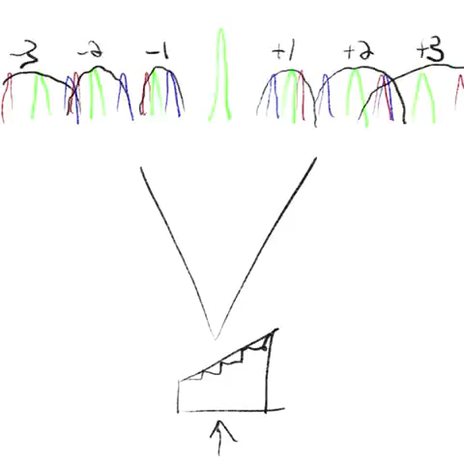
Grism Spectroscopy + Blocking Filter

Slide 7
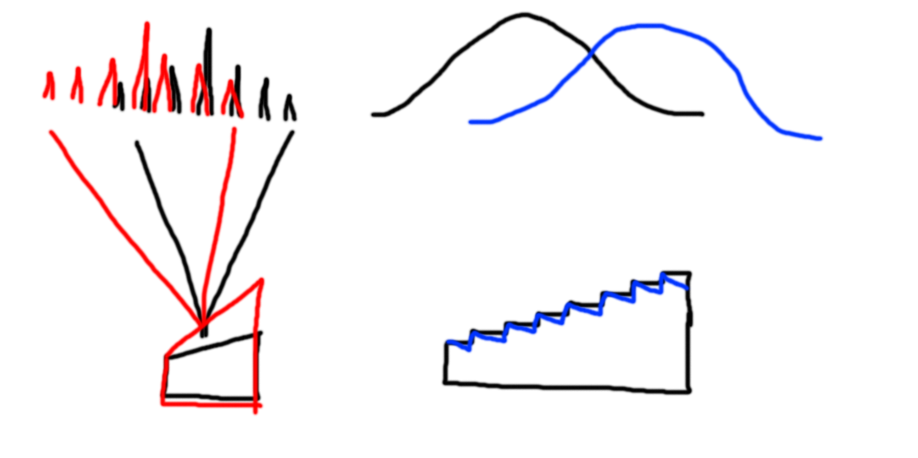
Blaze Wavelength and Undeviated Wavelength
The angles of the prism faces determine the diffracted beam deviation sideways.
The angle of the grating facets determine the blaze wavelength, i.e. where most of the power is directed.

Slide 8
Deviated Spectrum

Slide 9
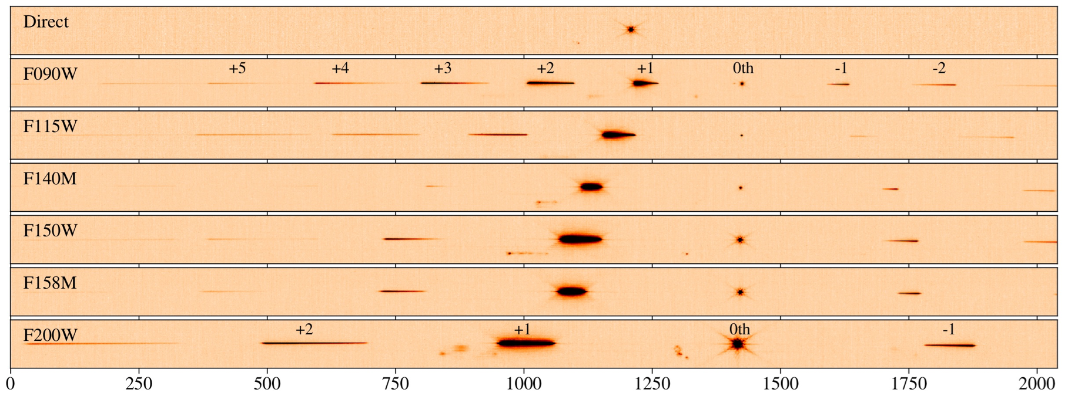
WFSS with NIRISS
Undeviated Wavelength

Slide 10
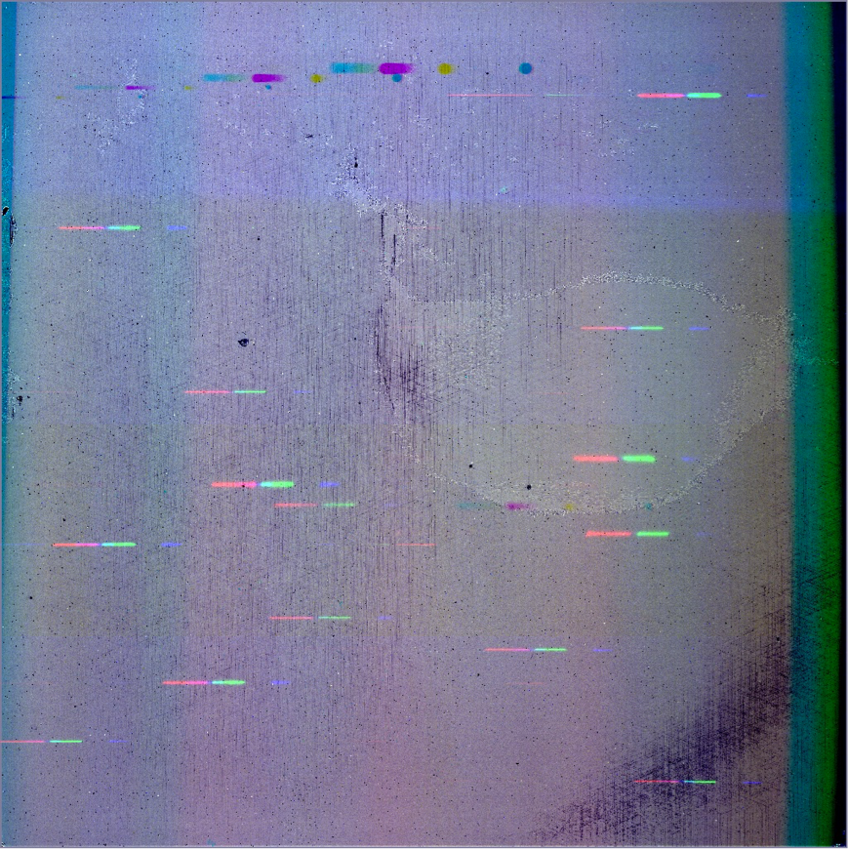
Due to deviation (and spectrum length) - FOV is smaller
Area lost
NIRISS

Slide 11
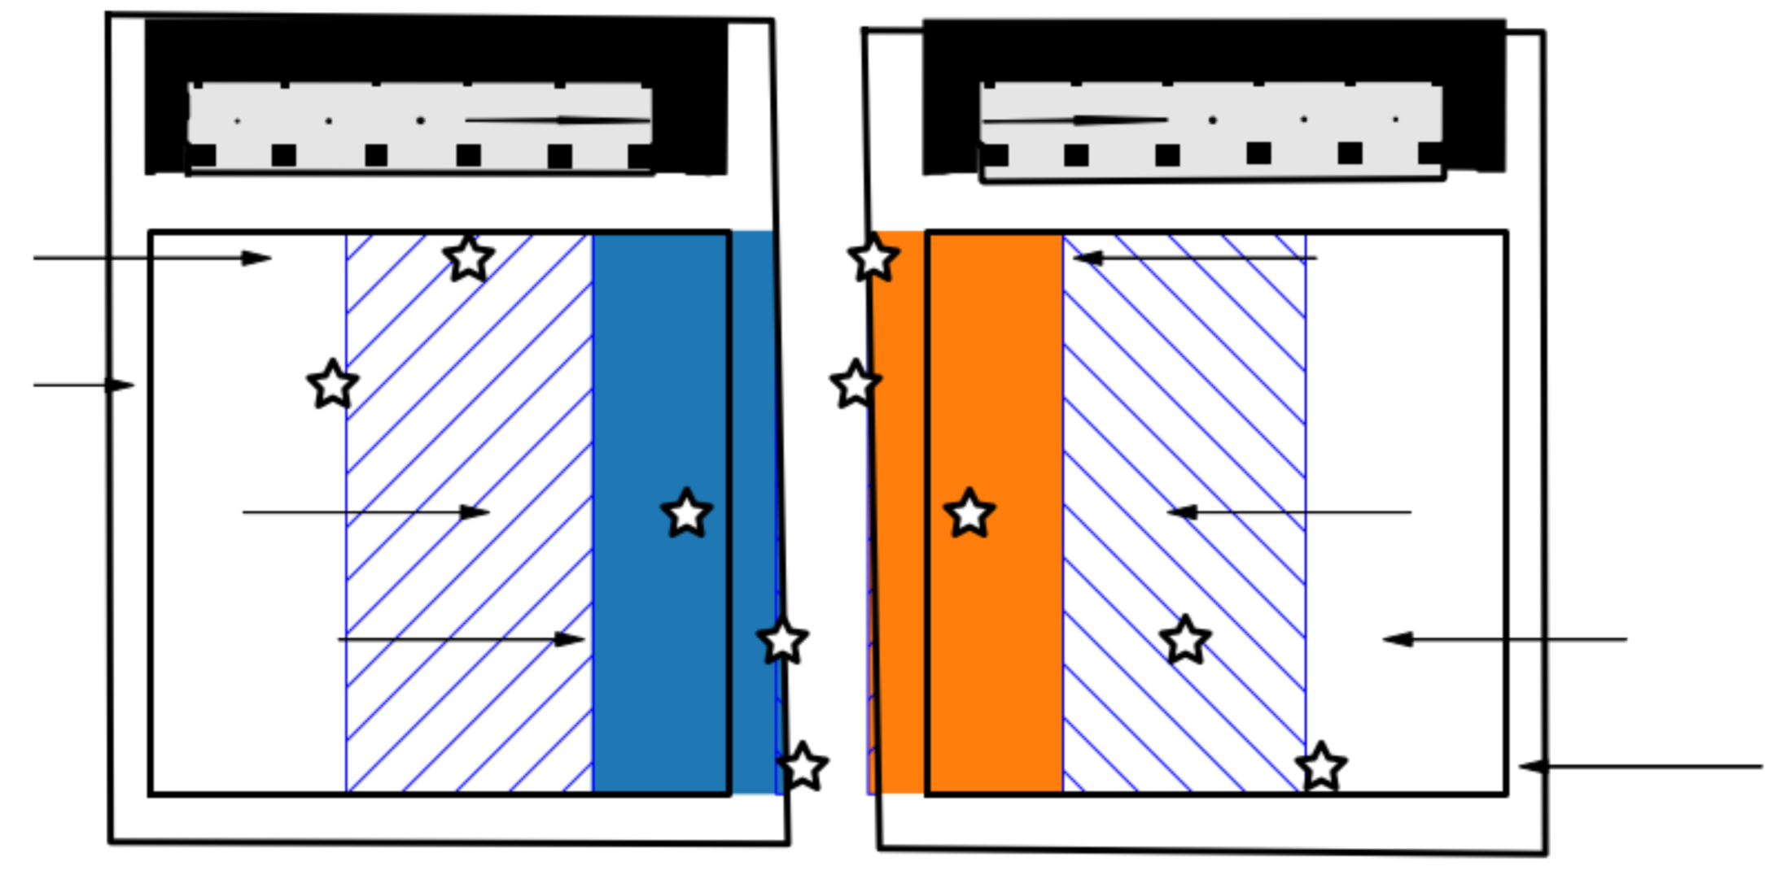
Effect is important for NIRCam
Field of View
Partial spectra
Detector
Full spectra
Area lost
Module A
Module B

Slide 12
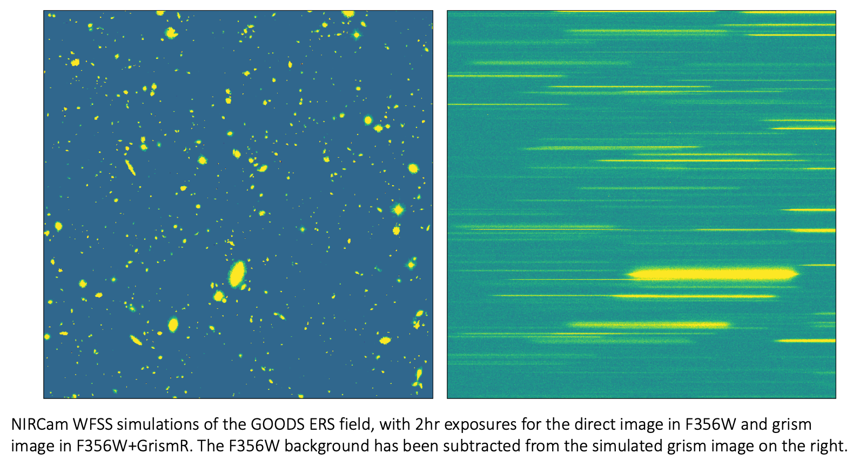
NIRCam WFSS Traces Example

Slide 13
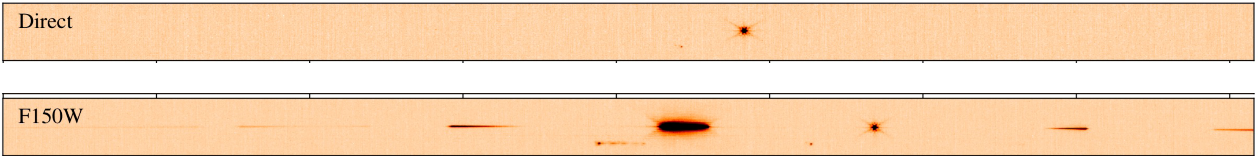
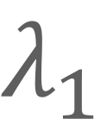
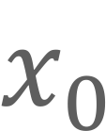
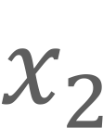
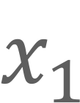
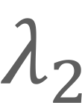
Wavelength Calibration Using a Direct Image
To wavelength calibrate spectra in your field, a direct image is needed to identify the true sky position of each target.
$$x_{2}$$
$$x_{1}$$
$$x_{0}$$
$$λ_{2}$$
$$λ_{1}$$

Slide 14
WFSS Side-by-Side Specs
NIRISS | Instrument | NIRCam
~150 | R | 1200-1600
0.8-2.2 microns | Wavelength Coverage | 2.4-5.0 microns
A little less than 2.2’x2.2’ FOV | Full Spectrum FOV | Depends on the filter ~1/3 of 2.2’x2.2’ FOV 2 Modules simultaneously!
F090W, F115W, F140M, F150W, F158M, F200W | Filter | F250M, F277W, F300M, F322W2, F335M, F356W, F360M, F410M, F430M, F444W, F460M, F480M
Low Background | Background | For many filters, need background subtraction
NIRCam Imaging or MIRI Imaging | Coordinated Parallel | MIRI Imaging or NIRISS Imaging. Plus, get simultaneous NIRCam imaging in shortwave channel

Slide 15
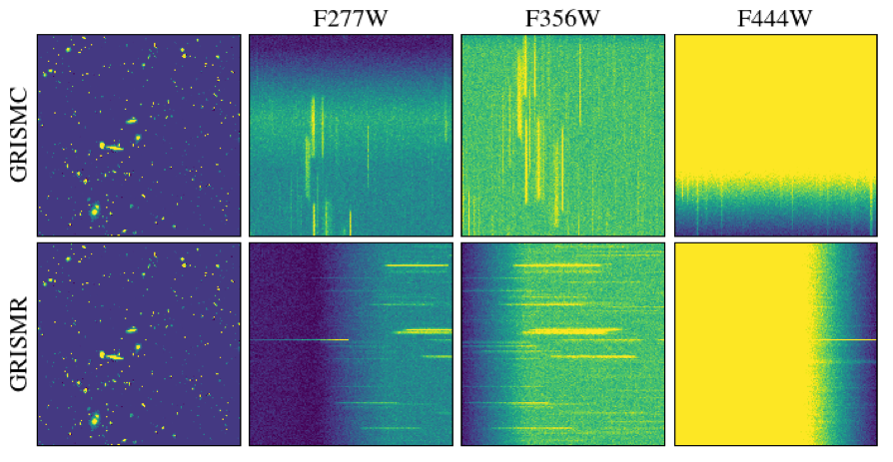
2 Orthogonal Grisms to Mitigate Contamination

Slide 16
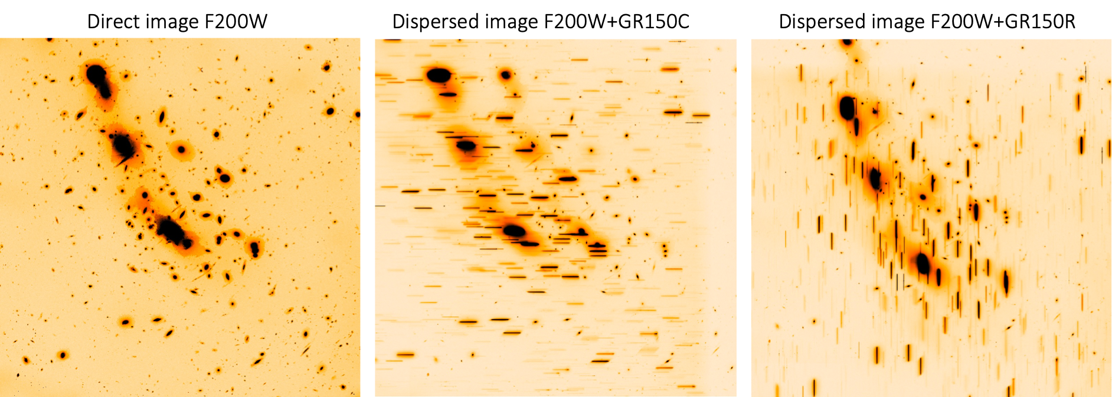
Same for NIRISS

Slide 17
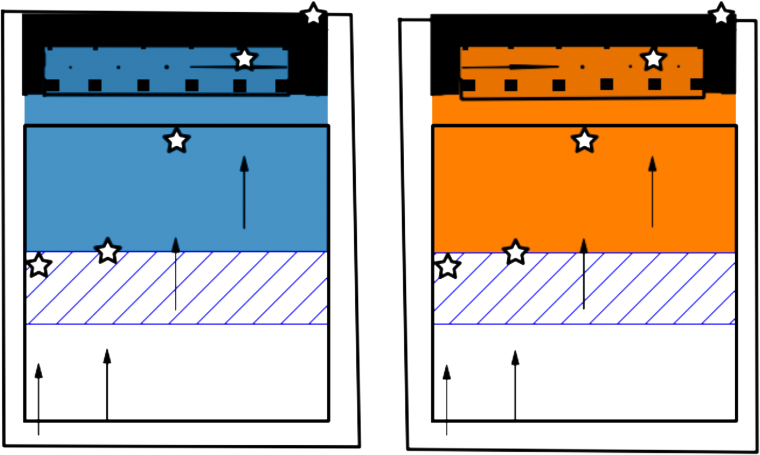
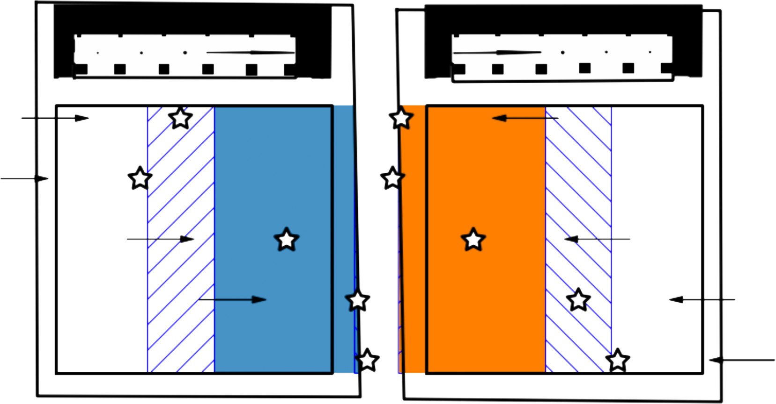
Optimal FOV for NIRCam is Small
GrismC
+
GrismR

Slide 18
A Word About Background
NIRCam WFSS benefits from many dithers to construct and subtract a “background” image.

Slide 19
WFSS Strengths and Weaknesses
(Compared with MOS/Slit Spectroscopy) - Operation-Wise
WFSS has no slit so the whole FOV contributes to the background —
No slit loss +
No need for a pre-imaging survey. Can do a blind survey of whole FOV +
Wavelength calibration requires direct images co-observations —
Constraints on field position angle is loose (facililates mosaics) +
Wavelength range is limited to the width of a blocking filter —

Slide 20
WFSS Strengths and Weaknesses
(Compared with MOS/Slit Spectroscopy) -
Science-Wise
WFSS is ideally suited for blind emission-line surveys and detection of continuum breaks in high-z galaxies +
Ideally suited for detection of high redshift galaxies : for example, Lyα emission line at z > 5.6 - 17 with NIRISS, and Lyα at z > 18 and optical Hα emission lines at z =2.8 – 6.6 with NIRCam +
Spatial resolution allows to map emission lines on physical scales of few kpc across redshifits (z>2) +
For an extragalactic blank field, there are ~ 3000 faint galaxies with < 28 AB magnitude +/—
Can use Coordinated PARALLEL NIRCam Imaging or MIRI Imaging +

Slide 21
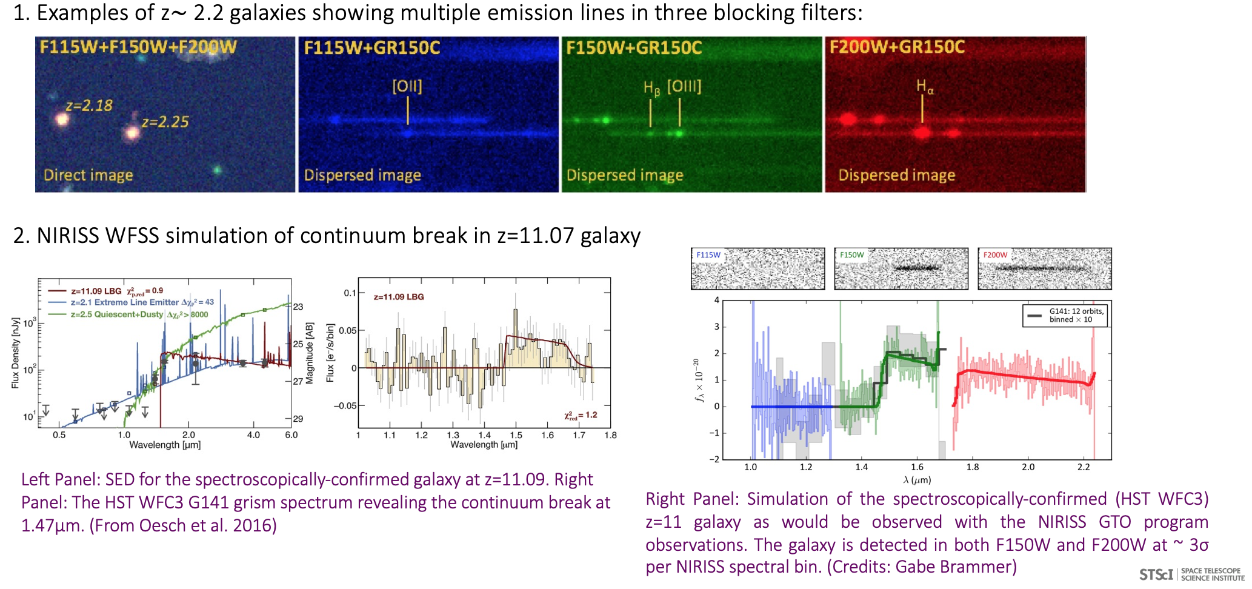

Slide 22
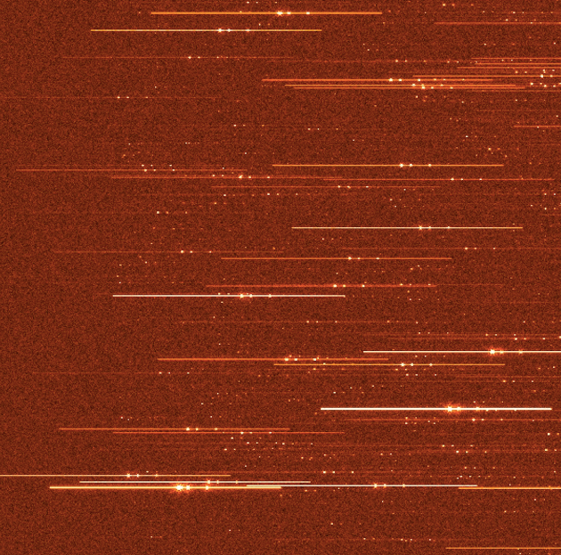
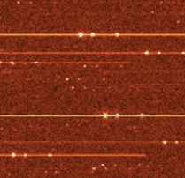
Simulated 2-hr NIRCam/Grism+F356W Spectrum
[ΟΙΙΙ] 4959/5007
Hβ
EW([OIII] 4959/5007) = 200/600 Å
EW(Hβ) = 180 Å
Continuum down to ~24 AB mag (~ 1 μJy)
Emission lines down to ~2x10⁻¹⁸ erg cm⁻² s⁻¹

Slide 23
WFSS Operations

Slide 24
NIRISS Operations
No Dither
Direct
GR150C
GR150R
Direct
Dither = 2
Direct
GR150C
GR150R
GR150R
GR150C
Direct
dither
Dither = 3,4,6,8,12,16

Slide 25
NIRISS Operations
No Dither
For each blocking filter
Direct
GR150C
GR150R
Direct
Dither = 2
For each blocking filter
Direct
GR150C
GR150R
GR150R
GR150C
Direct
dither
Dither = 3,4,6,8,12,16

Slide 26
NIRISS Operations
No Dither
Single Grism
For each blocking filter
Direct
GR150C
GR150R
Direct
Dither = 2
For each blocking filter
Direct
GR150C
GR150R
GR150R
GR150C
Direct
dither
Dither = 3,4,6,8,12,16

Slide 27
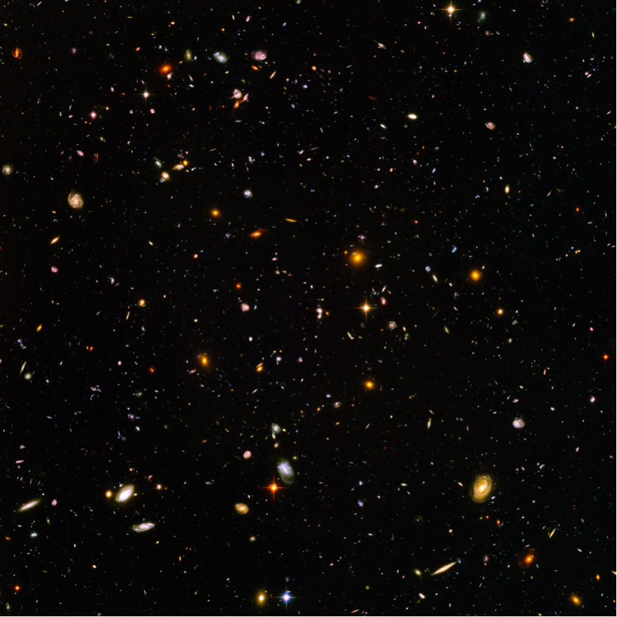
NDITHER=2
GRISM=BOTH
1 filter
GR150C
GR150R
DIRECT
DIRECT
GR150R
GR150C

Slide 28
NIRISS Operations
Option to use single grism (GR150C or GR150R) or BOTH
Dither Pattern Size: SMALL (0.3”), MEDIUM (0.6”) or LARGE (1.2”)
Always use FULL array for science mode

Slide 29
NIRCam Operations
Not recommended (if even allowed)
Single Grism - No Direct Image
…
GRISMR
GRISMR
GRISMR
dither
dither
Single Grism - With Dithers and Direct Images
…
GRISMR
Direct
GRISMR
Direct
Direct
Out of Field #1
Direct
Out of Field #2
dither
dither
dither
dither

Slide 30
NIRCam Operations
Both Grisms - With Dithers and Direct Images
…
GRISMR
Direct
GRISMR
Direct
Direct
Out of Field #1
Direct
Out of Field #2
1st
dither
dither
dither
dither
…
GRISMC
Direct
GRISMC
Direct
Direct
Out of Field #1
Direct
Out of Field #2
2nd
dither
dither
dither
dither
Add more such sequences if other blocking filters are needed

Slide 31
NDITHER=2
GRISMR
1 filter
DIRECT OUT OF FIELD #2
GRISMR
DIRECT
DIRECT OUT OF FIELD #1
GRISMR

Slide 32
NIRCam Operations
It is advised to take a direct image in the same blocking filters for the purpose of accurate wavelength calibration. The NIRCam WFSS sequence does not include the direct images in the same cross filter by default.
Short wavelength imaging will occur simultaneously with the grism integrations which typically have long integrations. Saturation in the SW imaging can be a concern and can be mitigated with suitable choice of filters and exposure parameters.
Transmission of the Module B grism is 25% less than that in Module A because it lacks AR coating on one surface.
Coordinated Parallel (MIRI or NIRISS imaging) is allowed with NIRCam WFSS.
For red filters, background subtraction is important. You need several dither positions to build up the sky image.

Slide 33
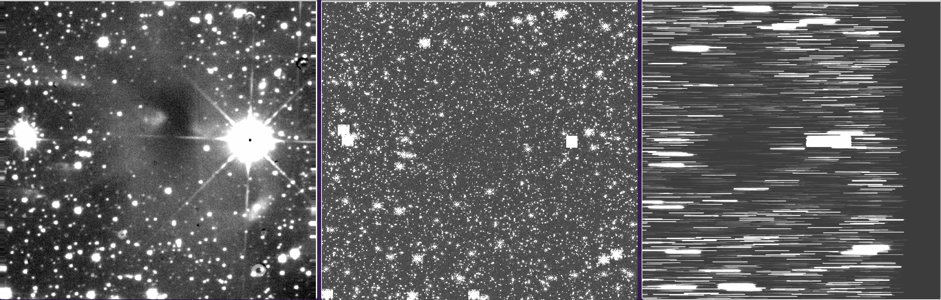
End of the WFSS Session
NIRCam/Grism + F430M (30 sec)
CO2 ice absorption @4.3 μm will be seen in the spectra of the background stars.
B335 Dark Cloud
K-band, 3.2 hrs
UKIRT
NIRCam + F430M
1 sec
Faint stars added

Slide 34
Real Data!!

Slide 35
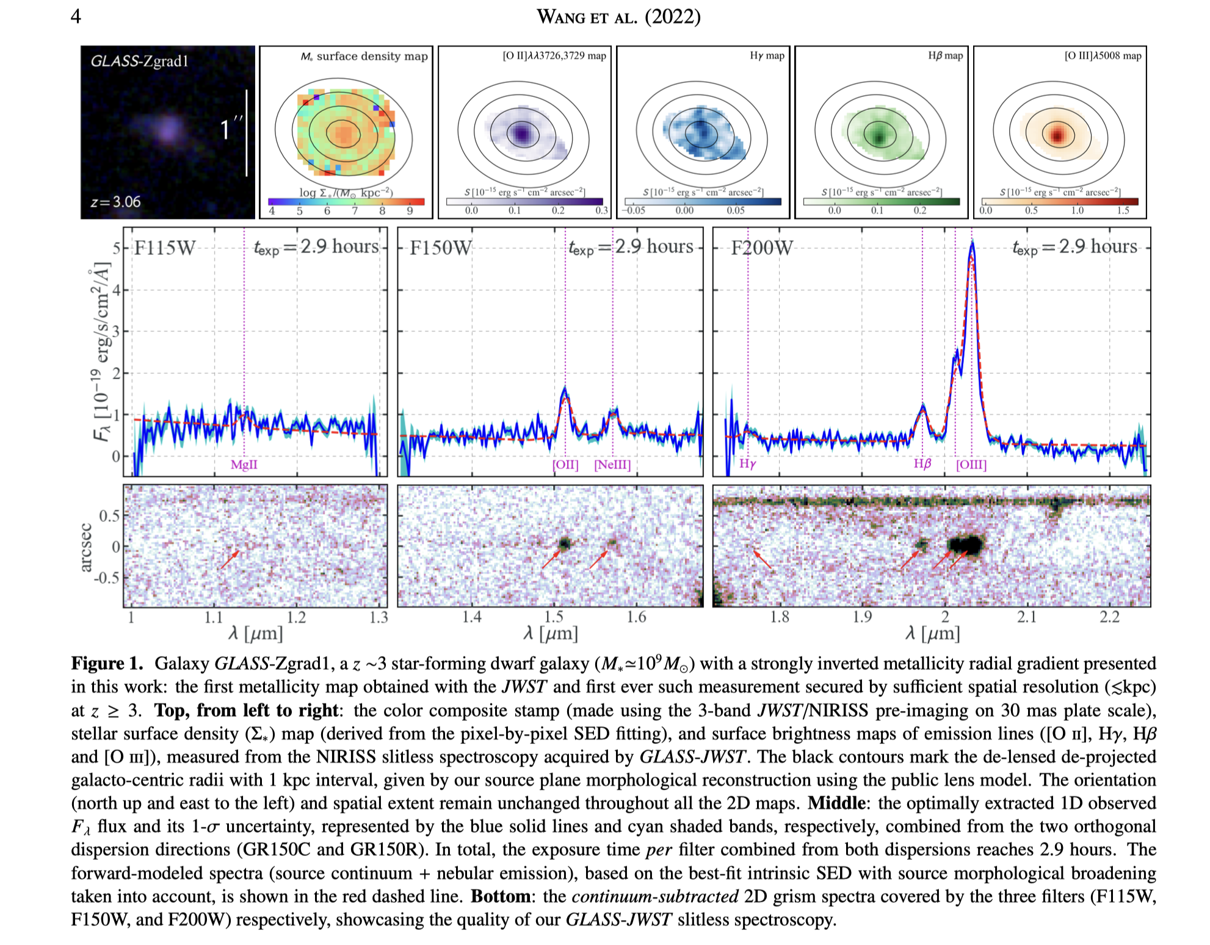
NIRISS – GLASS Wang+2022

Slide 36
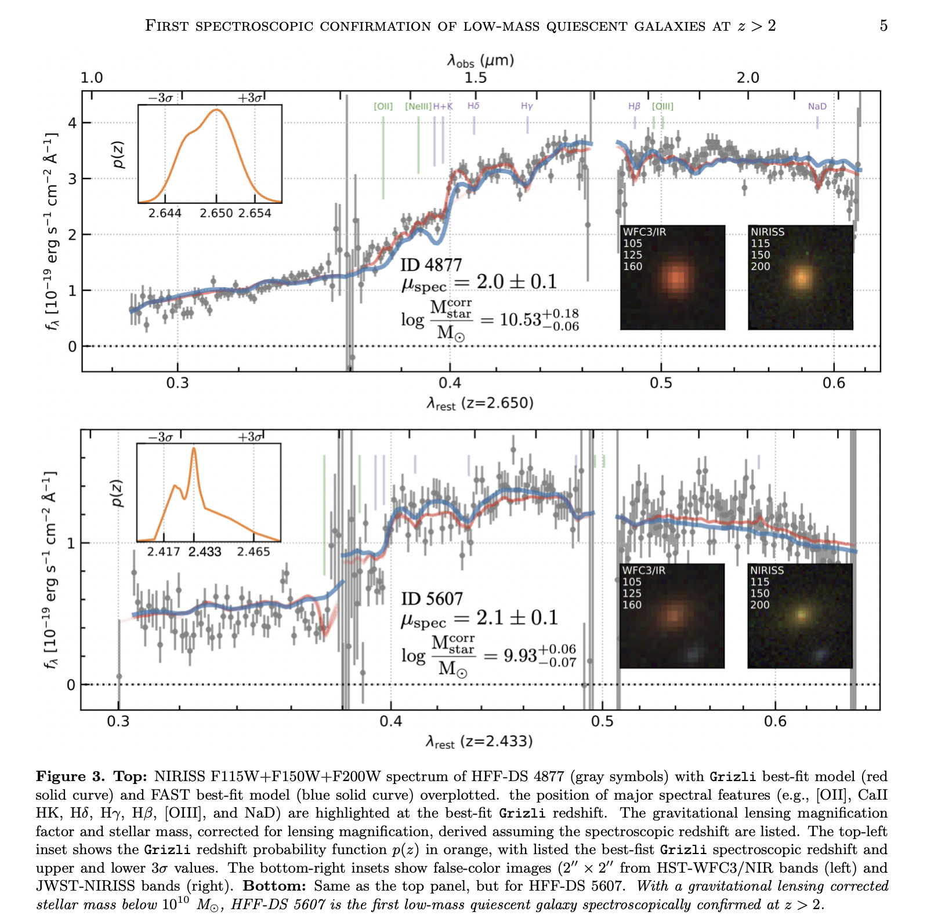
NIRISS – GLASS Marchesini+2022

Slide 37
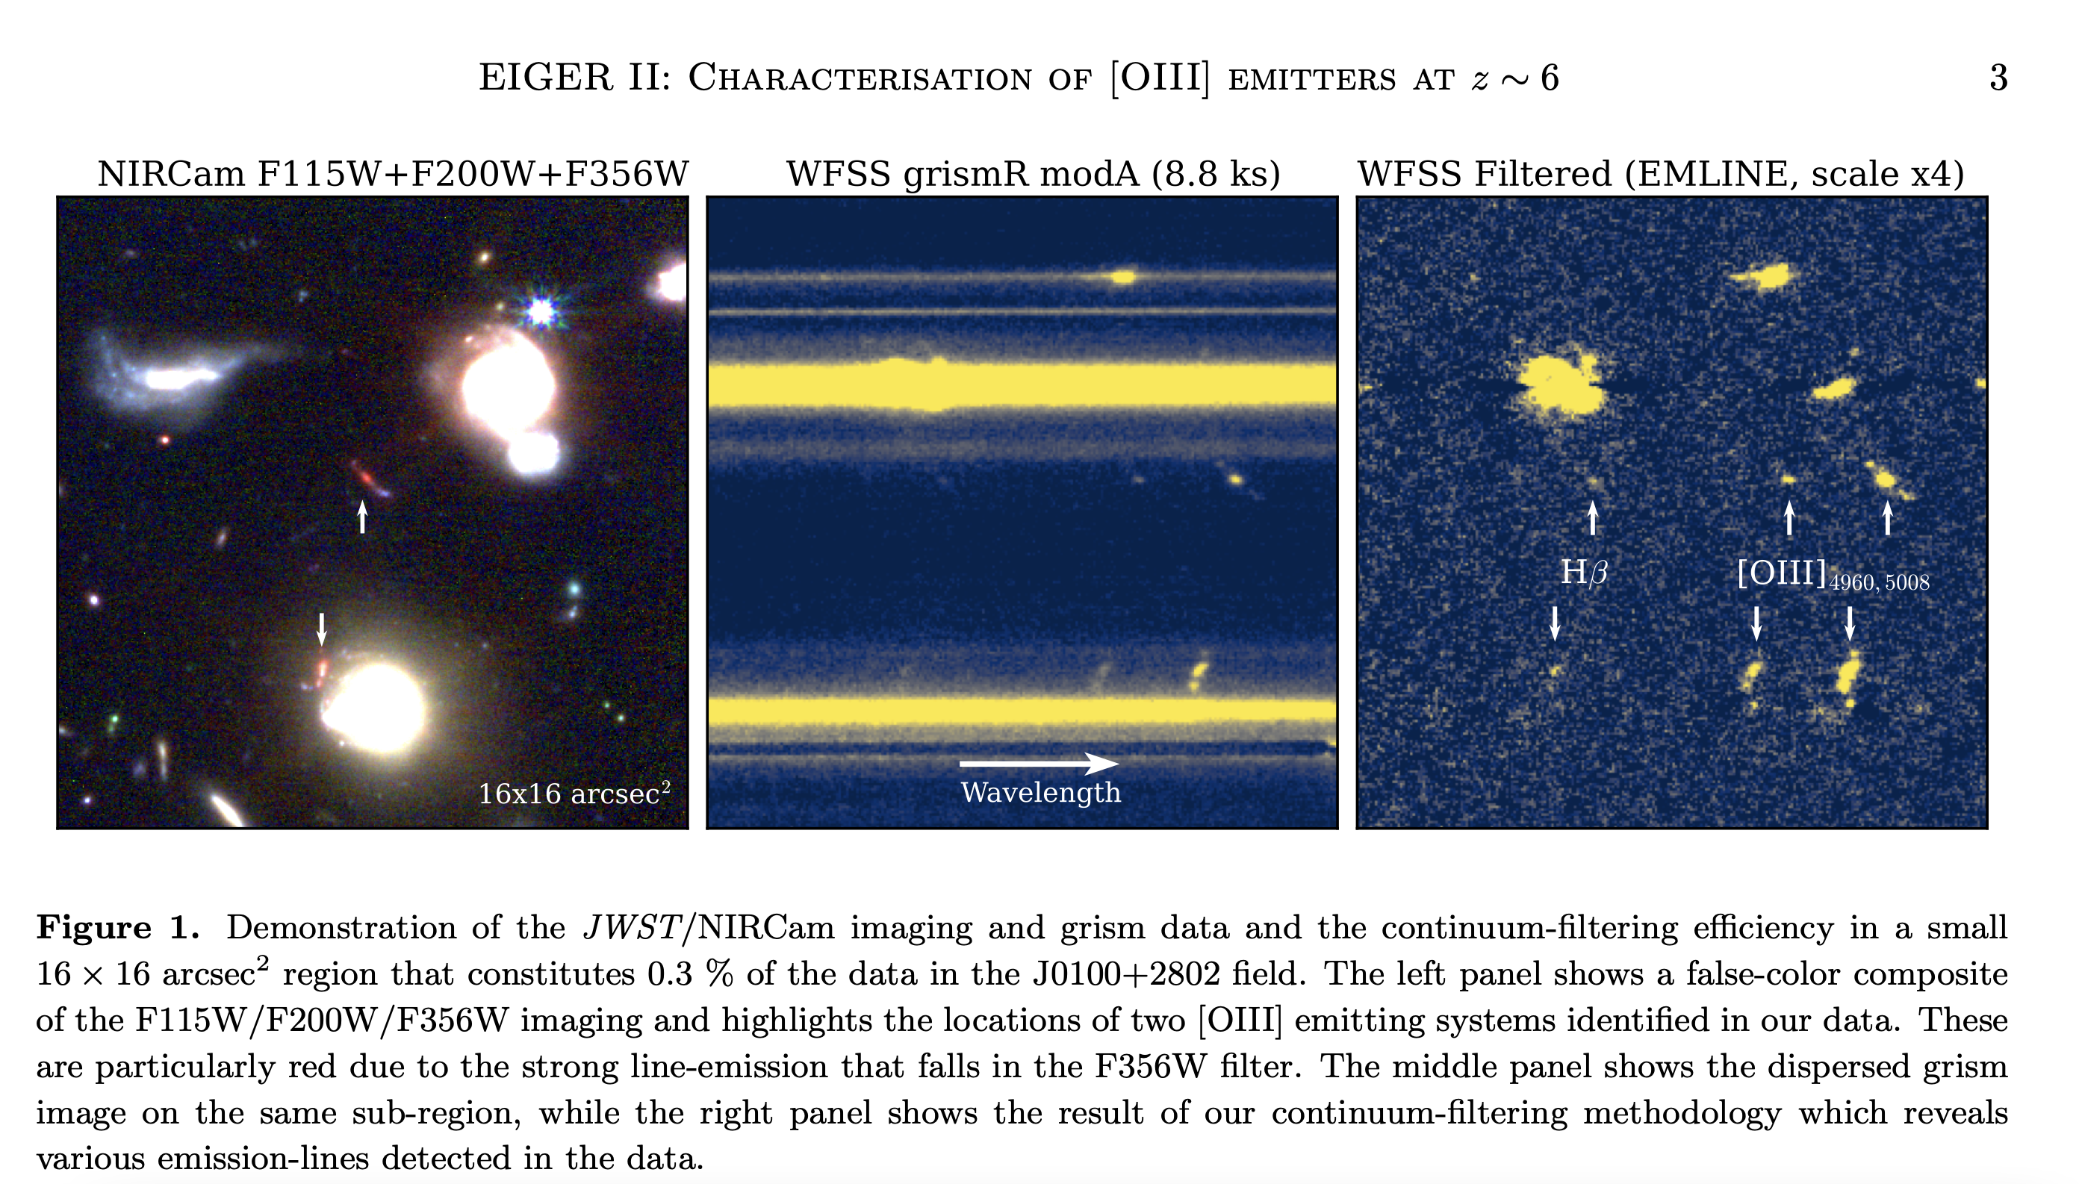
NIRCAM – GRISMR (Mathee+2022)

Slide 38
Supplementary Material

Slide 39
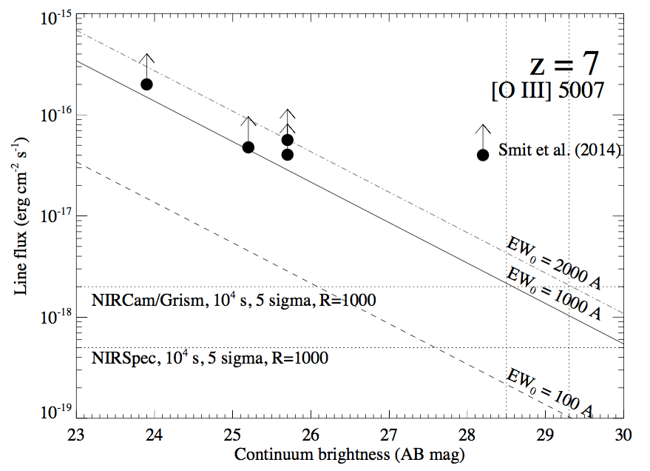
Sensitivities compared with NIRSpec
credit: E. Egami

